Slide 1
PRESENTATION ON FUEL
College: NEOTECH INSTITIUTE OF TECHNLOGY
Department OF MECHANICAL ENGINEERING
Students: Soham Patel
Veeral Patel
Aniket Shimpi
Krunal Shah
Guided By;-
Mukesh Keshwani

Slide 2
List Of Fuels:
Petrol (Gasoline)
Diesel
Kerosene
Butanol
Jatropha Oil
Jet Fuel
Hydrogen Fuel
Algae Fuel
Vegetable Oil Fuel
CNG

Slide 3
Types Of Fuels:
Conventional
Fuels
UnConventional
Fuels
Conventional Fuel: traditional energy sources or fossil fuels (petroleum, oil, coal, propane, and natural gas); in some cases nuclear materials such as uranium are also included.
UnConventional: Is petroleum produced or extracted using techniques other than the conventional (oil well) method.

Slide 4
Conventional Fuels
→Coal
→Petrol
→Diesel
→Anthracite
→Kerosene
→Bituminous
→Lignite
→Sulfite liquor
→Oil shale

Slide 5
Unconventional Fuels
Butanol
Jatropha Oil
Jet Fuel
Hydrogen Fuel
Algae Fuel
Vegetable Oil Fuel
CNG

Slide 6
Terms Will Be Used In Presentation:
Fractional distillation
Flash Point
Autoignition Temperature
Octane and Cetane Number

Slide 7
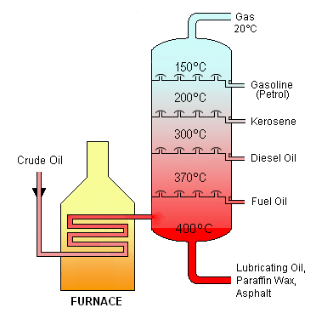
Fractional Distillation
Fractional Distillation: Is the separation of a mixture into its component parts, or fractions, such as in separating chemical compounds by their boiling point by heating them to a temperature at which one or more fractions of the compound will vaporize.

Slide 8
Flash Point
Is the lowest temperature of volatile material at which it can vaporize to form an ignitable mixture in air. At the flash point, the vapor may cease to burn when the source of ignition is removed.

Slide 9
Autoignition Temperature
The autoignition temperature or kindling point of a substance is the lowest temperature at which it will spontaneously ignite in a normal atmosphere without an external source of ignition, such as a flame or spark.

Slide 10
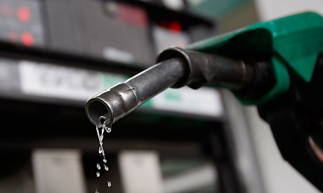
Petrol
Gasoline or petrol is a transparent, petroleum-derived
oil that is used primarily as a fuel in internal combustion engines.
There is no chemical formula for gasoline. This is because gasoline
is a mixture of variable hydrocarbons obtained from crude oil.
It will always have a variable composition.

Slide 11
Fractional Distillation-150 C
Density- 0.71-0.77 Kg/L
Flash Point- -43 C
Autoignition Temperature- 280 C
Energy Content- 35 MJ/L

Slide 12
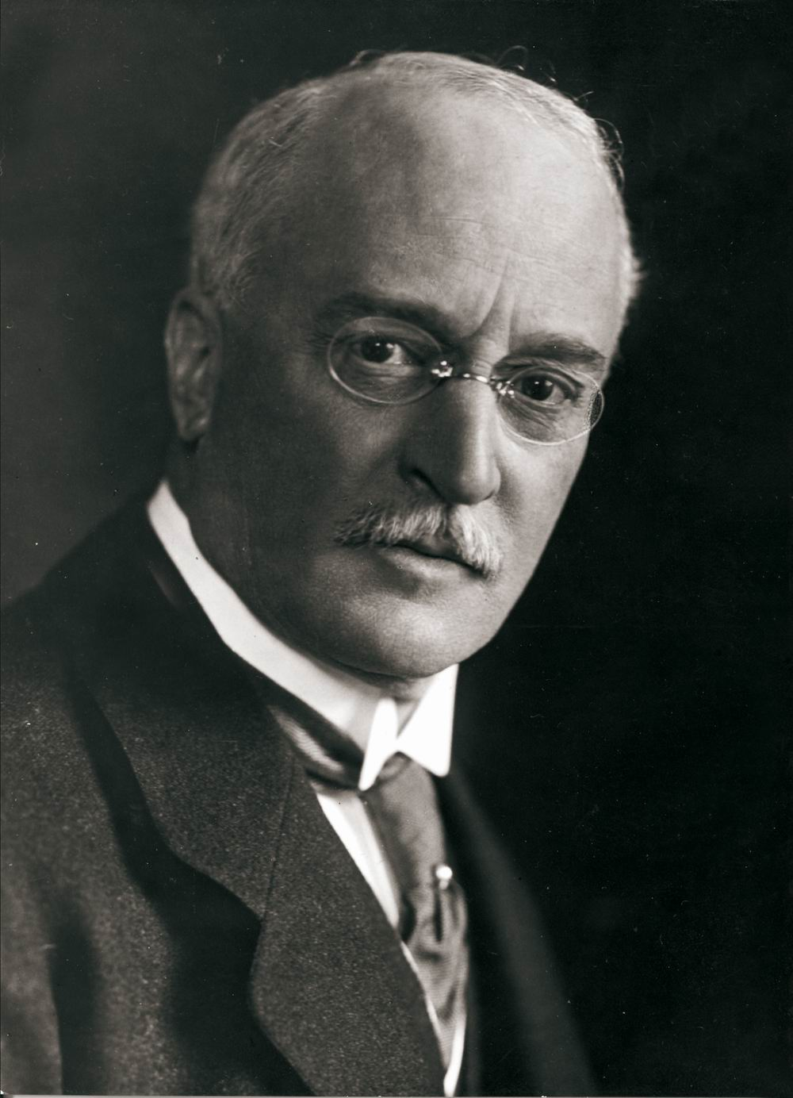
Diesel
The word "diesel" is derived from the family name of German
inventor Rudolf Diesel who in 1892 invented the compression-ignition engine.

Slide 13
Fractional Distillation- 300 C
Density- 0.832 kg/l
Flash Point- >62 C
Autoignition Temperature- 210 C
Energy Content- 35.86 MJ/L

Slide 14
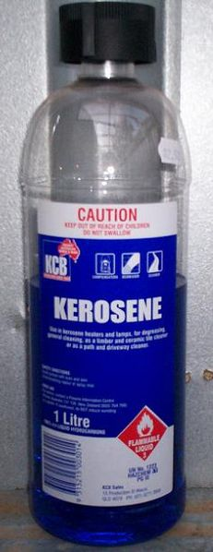
Kerosene
Kerosene is a combustible hydrocarbon liquid.
The name is derived from
Greek: (keros) meaning wax.
The word "Kerosene" was registered as a trademark
by Abraham Gesner in 1854

Slide 15
Fractional Distillation- 200 C
Density- 0.78–0.81 g/cm³
Flash Point- >38 - 72 C
Autoignition Temperature- 220 C
Energy Content- 43.1 MJ/kg

Slide 16
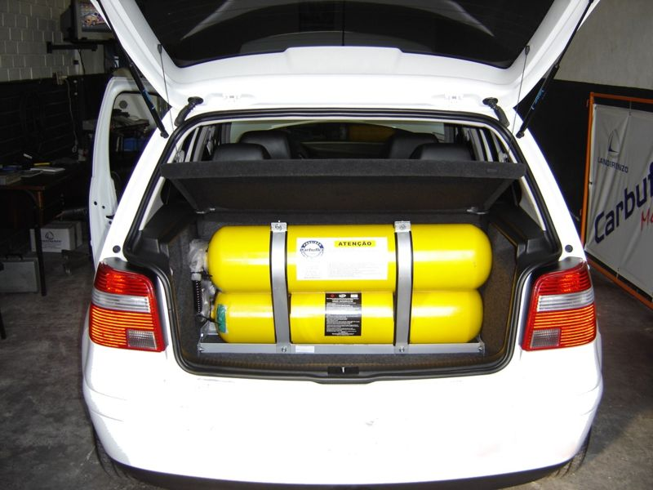
CNG (Compressed Natural Gas)
CNG emits significantly less pollutants
(e.g., carbon dioxide (CO₂), unburned
hydrocarbons (UHC), carbon monoxide(CO), nitrogen oxides (NO_{x}),
sulfur oxides (SO_{x}) and particulate matter (PM)) than petrol.

