Slide 2
Group members
Herbha Jagruti
Kakadiya Samir
Kapadiya Nijunj
Katharotiya Kajal
Limbasiya Tushar
Maheta Janaki
Mahida Sunil
Padsala Jatin

Slide 3
CIUTCHES
Clutch is used to transmit the power from driving shaft to driven shaft.
The classification of clutches is as follows.
Clutches
mechanical
pneumatic
hydraulic
electromagnetic
Positive contact clutches
Friction clutches
Jaw clutch
Toothed clutch
Disc clutch
Cone clutch
Centrifugal clutch

Slide 4
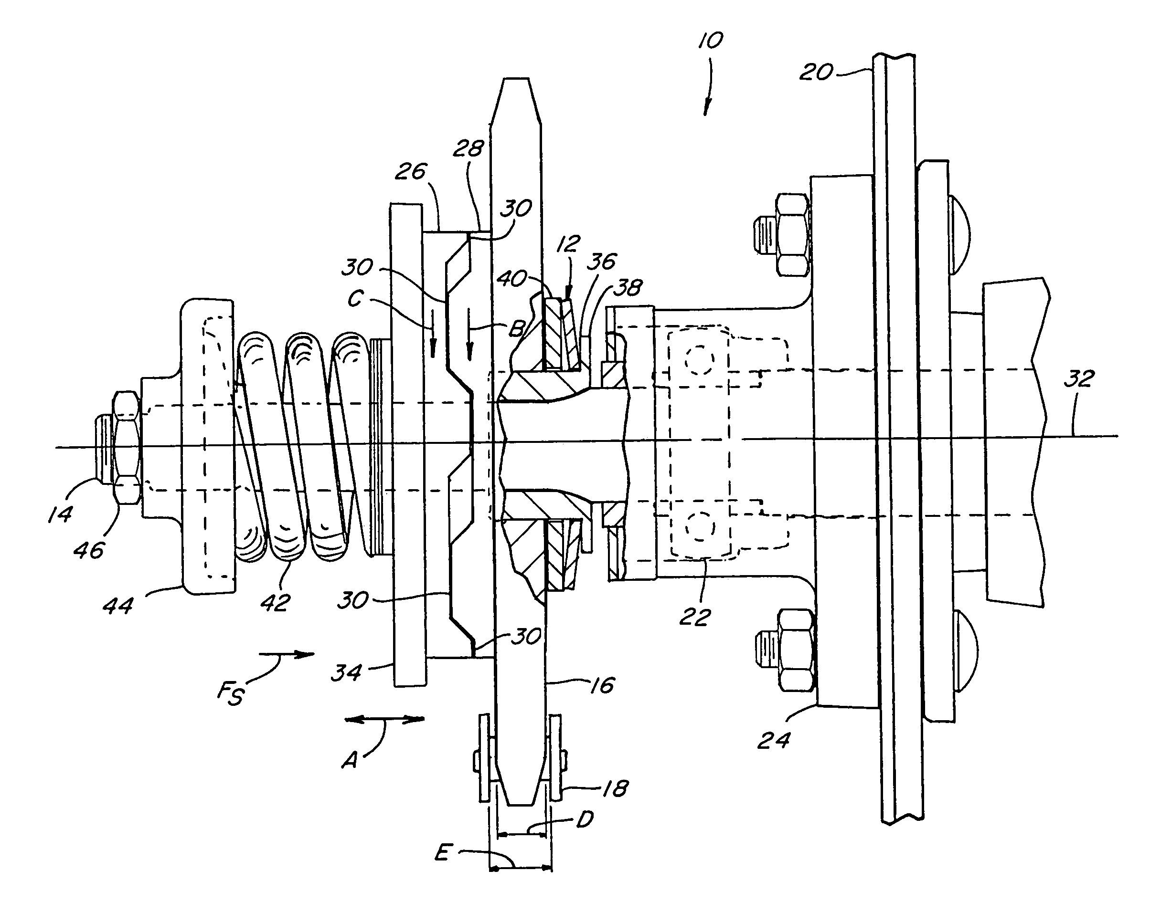
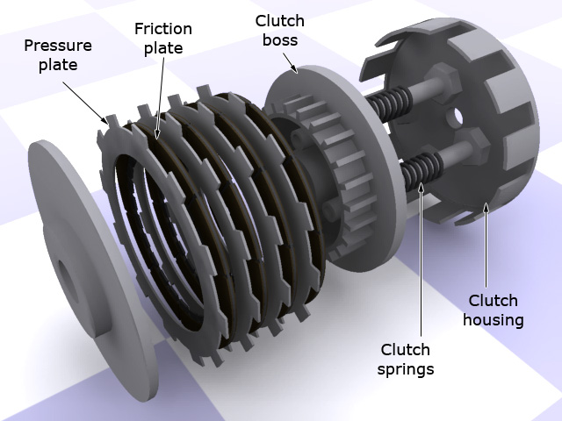
Disc clutch
One flange keyed rigidly to the driving shaft, other flange fitted to the driven shaft by splines so that it can slide on the driven shaft
The spring is pressed the driven flange to the driving flange .
In normal operation both shaft remain engaged by clutch due to spring force.
When power is not required at driven shaft, driven flange is disengaged from driving flange by operating lever.
The torque is transmitted by friction between the flanges and friction disc .
The amount of torque transmitted is depend on axial pressure on the flange by spring, contact surface area and co-efficient of friction of contact surfaces.
Single disc clutch are used in automobiles.
When large torque transmission is required the multi disc clutch are used.

Slide 5
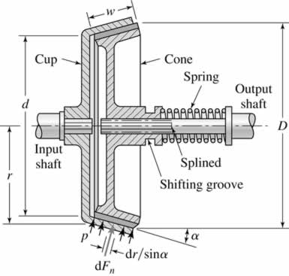
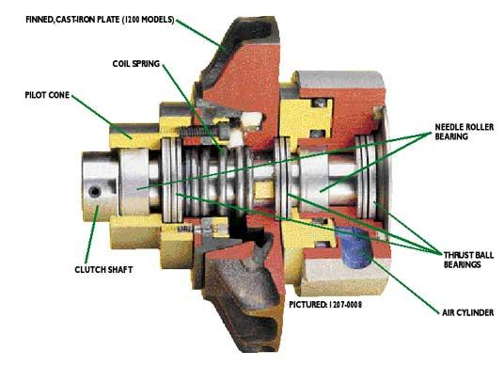
Cone clutch
One internal cone fixed to the driving shaft, another cone fitted on the driven shaft which is free to slide axially on the driven shaft.
The clutch is engaged by bringing the two conical surface in contact . The torque is transmitted by friction between contact surfaces of cones. The spring holds cone surfaces in contact and maintains the pressure between them. The operating lever used only for disengagement of the clutch. The main advantage of cone clutch over the disc clutch is very simple and required less axial pressure to disengaged the clutch.

Slide 6
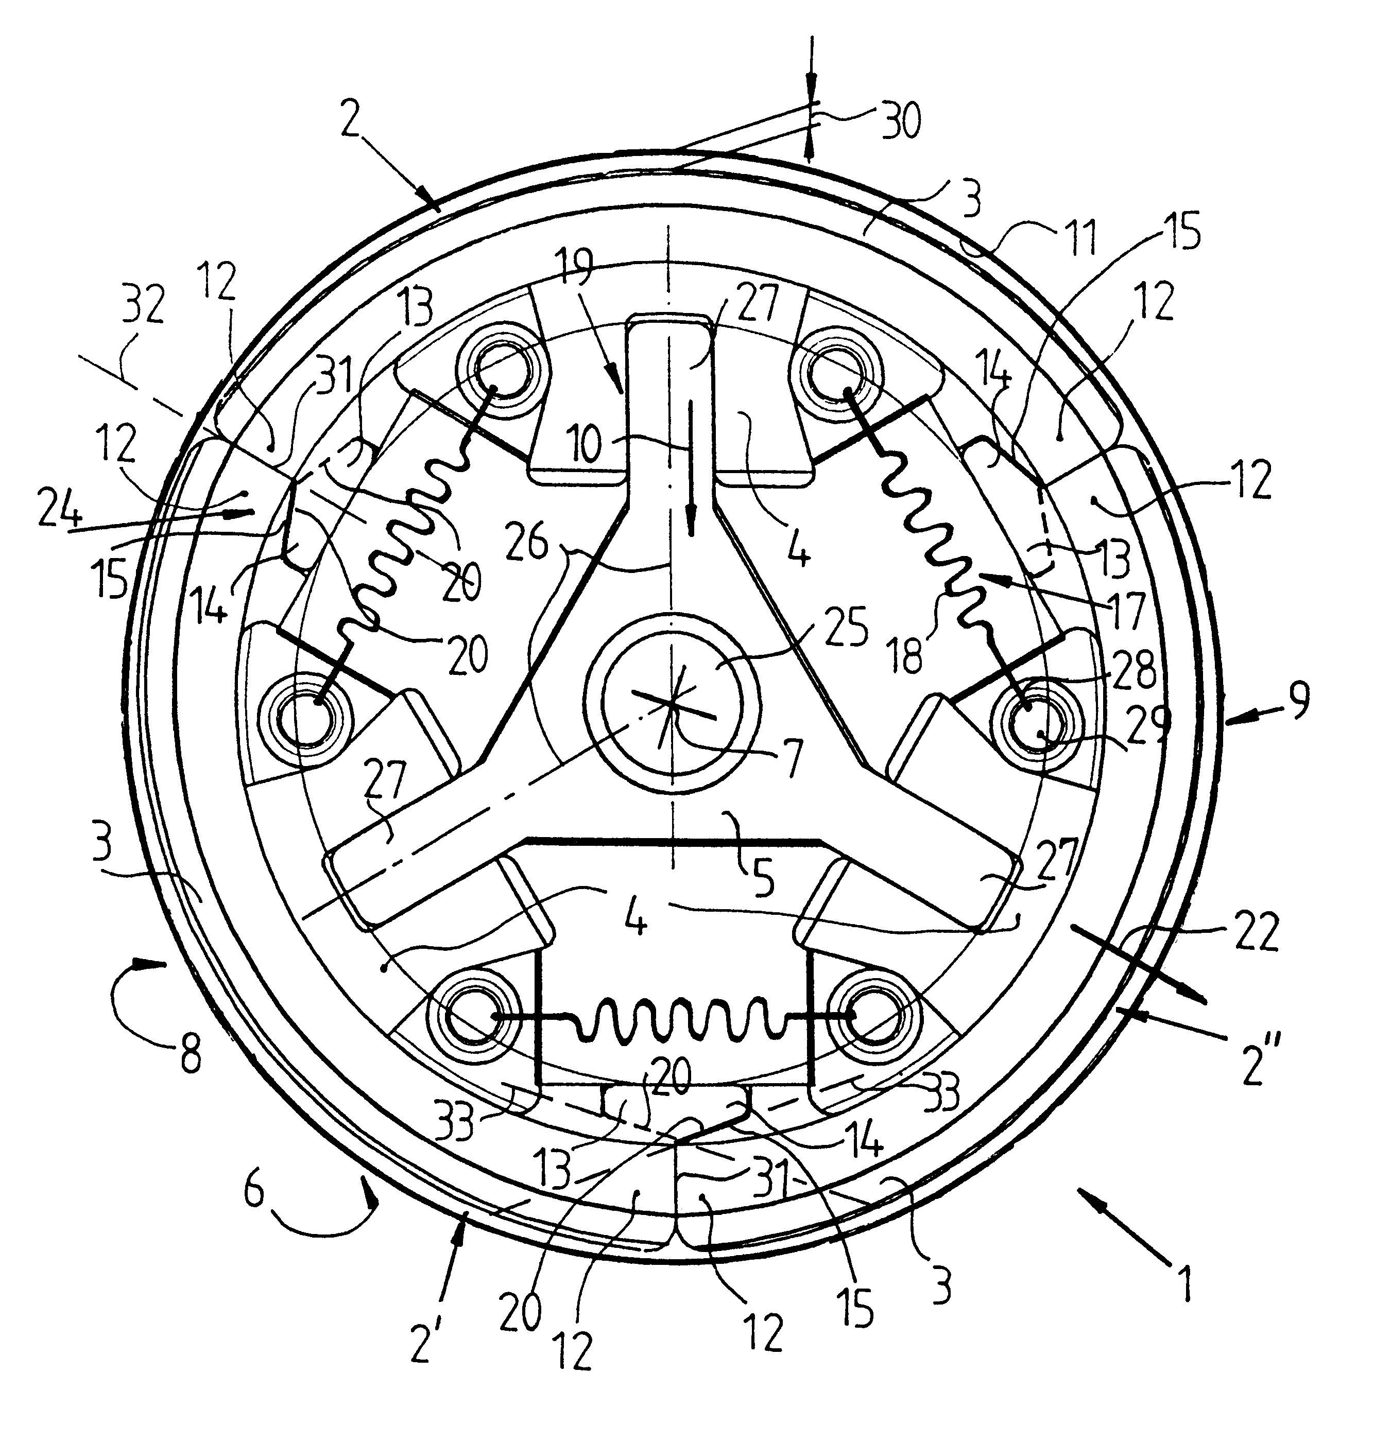
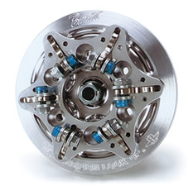
Centrifugal clutch
It consists of a number of shoes on the inside of the drum of the pulley as shown in fig. the upper surface of the shoes are covered with a friction material.
The shoes can move radially in spider. The shoes are held in slots of the spider by help of springs.
The spider is fitted on the driving shaft . The springs exert radiallly inward force which is constant.
Due to mass, when driving shaft revolving, the mass of shoes causes a radially Out word force.
This outward force increases with speed of shoes revolving with driving shaft.
When centrifugal force is equal to spring force, the shoes is just floating. But when centrifugal force higher than the spring force the shoes moves outward and comes in to contact with the driven member and presses against it.
The increase of speed causes the shoes to press harder and clutch transmit more power.

Slide 7
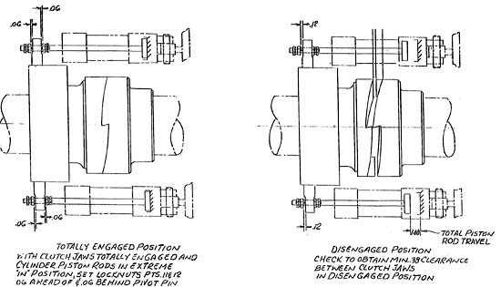
JAW CLUTCH
The jaw clutch consist of segmental projections or dogs on one of the flange and corresponding recesses on the flange on the driven shaft .Driving flange rigidly keyed to the driving shaft while the other flange is keyed to driven shaft by splines so that it can slide on that shaft. Sliding flanges which moves to fixed flanges by help of operating laver. The sliding flange engage with the fixed flange to transmit the motion and power from driving shaft to the driven shaft.

Slide 8
THANK YOU

