Slide 1
G.K.BHARAD INSTITUTE OF ENGINEERING
SUBJECT:- ENGINEERING GRAPHICS
BRANCH:- MECHANICAL
DIVISION:- A
MADE BY:- NADAR SAPNA S..SR NO .1

Slide 2
Why Study Drafting?
Drafting is a form of graphic communication
“A picture is worth a thousand words.”

Slide 3
Drafting as a Language
Drafting is called a “universal language”
Symbols (lines and figures) have specific meaning are used
The symbols accurately describe the shape, size, material, finish, and fabrication or assembly of a product

Slide 4
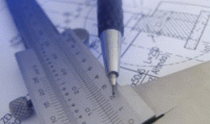
Drafting as a Language
Drafting is also the “language of industry”
Industry uses this precise language because the drawings must communicate the information the designer had in mind to those who produce the product.

Slide 5
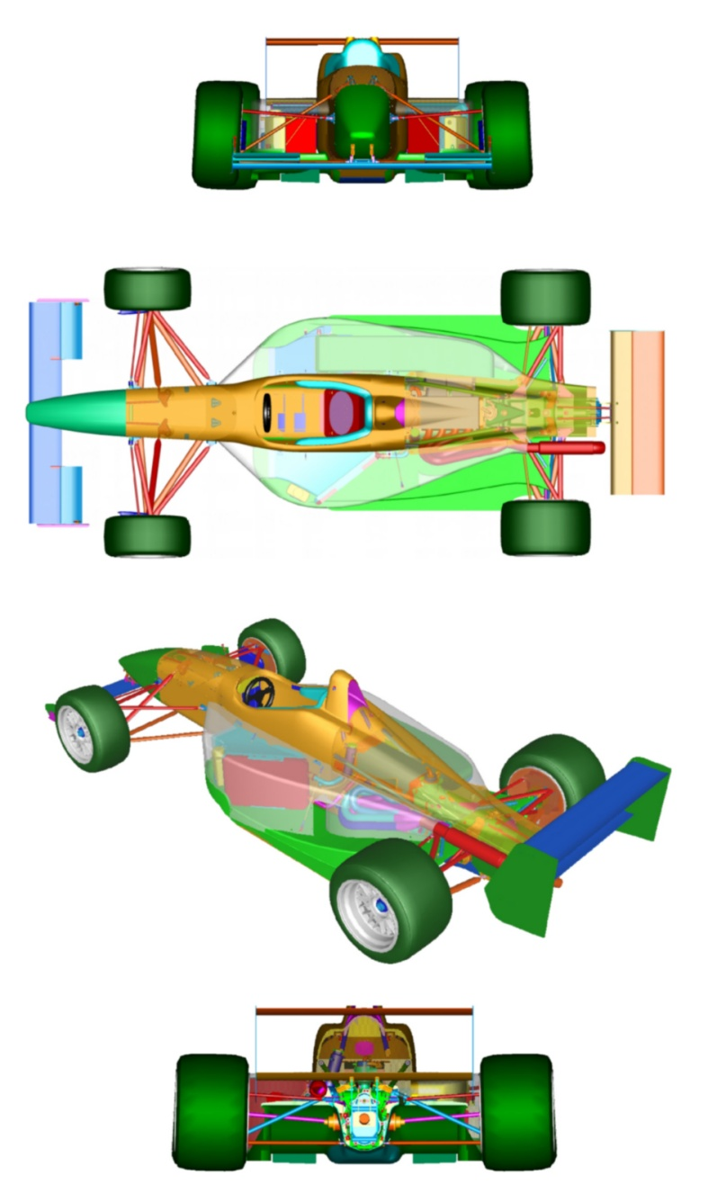
Fields of Drafting
Aerospace
Architectural
Automotive
Electrical
Electronic
Printed circuitry design
Topographical
ETC…
Yes! IT IS EVERYWHERE!!

Slide 6
Drawing board
In order to prevent warping ,the drawing board is made of narrow strips glued edge to edge with well seasoned pine or soft wood.
Surface of the board should be free from cracks and it should be absolutely flat.

Slide 7
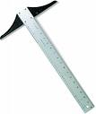
T- Square
Mostly T-Square is made of two parts.
1)The blade
2)The stock
Paper Set-Up
Horizontal Lines
Base for triangles to draw vertical lines.

Slide 8
Mini Drafter
Mini drafter is used in many drawing and design offices to do work faster.
It serves the purpose of T-Square , Set-Square , Protractor and Scales.
Two blades of the drafter are accurately set to right angles to each other.

Slide 9
Drafting Equipment
Compass
Draw circles and arcs
Protractor
Measure and layout angles
Templates
Drawing repetitive features

Slide 10
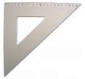
Triangles
Tool for drawing vertical & inclined lines
45° Triangle
30°-60° Triangle

Slide 11
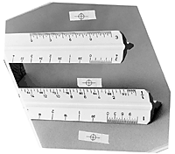
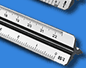
Types of Scales
Engineer (Civil)
Mechanical drafter
Metric
Architecture

Slide 12
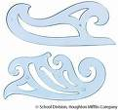
French Curve
Also called an Irregular curve
Consists of a variety of curves that can be used when arcs are not satisfactory

Slide 13
Pencils
Mechanical
Lead Holders
Wooden

Slide 14
Leads
6B
5B
4B
3B
2B
SOFT
Very soft leads, smudge easily. Used for art work of various kinds and full-size details in architectural drawing.
B
HB
F
H
2H
3H
MEDIUM
General purpose work. Softer grades (right) used for technical sketching, lettering, freehand work. Harder grades (left) used for line work on machine & architectural drawings.
9H
8H
7H
6H
5H
4H
HARD
Used where extreme accuracy is required. Softer grades (right) used for line work on engineering drawings. Draw very light lines.

Slide 15
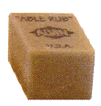
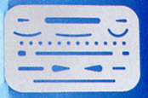
Drafting Equipment
Erasers
Brush
Clean drawings w/out smudging
Erasing Shield
Erase near lines that should not be erased

Slide 16
Divider
Looks like a compass, but both legs have steel pints at the end
Tool used for measurement purposes

Slide 17
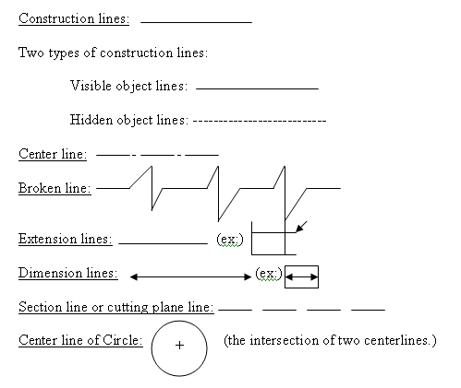

Slide 18
Border line
The border line is the heaviest (thickest) line in sketching.
First, draw light construction lines as a guide.
Then, go over them using a pencil with a heavy rounded point to provide the border lines.

Slide 19
Center line
Centerlines are made up of alternate long (3/4 in. to 1 ½ in.) and short (1/8 in.) dashes with 1/16 in. spaces between.
These are drawn about the same weight as dimension and extension lines, and are used to locate centers of symmetrical objects.

Slide 20
Cutting plane Line
A cutting-plane line indicates where an object has been cut to show interior features.
Two types are used:
¼ in. dashes with 1/16 in. spacing
A long dash (3/4 in. to 1 ½ in.), then two short dashes (1/8 in.) with 1/16 in. spacing.
Draw the cutting-plane line slightly heavier than an object line, using a pencil with a rounded point.

Slide 21
CLASSIFICATION OF ENGG. CURVES
1. CONICS
2. CYCLOIDAL CURVES
3. INVOLUTE
4. SPIRAL
5. HELIX

Slide 22
What is Cone ?
It is a surface generated by moving a Straight line keeping one of its end fixed & other end makes a closed curve.
The fixed point is known as vertex or apex.
The closed curve is known as base.
Vertex/Apex
If the base/closed curve is a circle, we get a cone.
90º
If the base/closed curve is a polygon, we get a pyramid.
Base
Notes:
there is no objection

Slide 23
The line joins apex to the center of base is called axis.
If axes is perpendicular to base, it is called as right circular cone.
If axis of cone is not perpendicular to base, it is called as oblique cone.
Vertex/Apex
Cone Axis
Generator
The line joins vertex/ apex to the circumference of a cone is known as generator.
90º
Base

Slide 24
CONICS
Definition :- The locus of point moves in a plane such a way that the ratio of its distance from fixed point (focus) to a fixed Straight line (Directrix) is always constant.
Conic Curve
M
P
Directrix
F
C
V
Focus
Fixed straight line is called as directrix.
Fixed point is called as focus.

Slide 25
The line passing through focus & perpendicular to directrix is called as axis.
The intersection of conic curve with axis is called as vertex.
Conic Curve
M
P
Axis
Directrix
F
C
V
Vertex
Focus

Slide 26
Conic Curve
M
P
Axis
Directrix
F
C
V
Vertex
Focus
N
Q
Distance of a point from focus
Ratio =
Distance of a point from directrix
= Eccentricity
= PF/PM = QF/QN = VF/VC = e

Slide 27
ELLIPSE
Ellipse is the locus of a point which moves in a plane so that the ratio of its distance from a fixed point (focus) and a fixed straight line (Directrix) is a constant and less than one.
P
Ellipse
M
Axis
Directrix
Vertex
F
C
V
Focus
Eccentricity=PF/PM = QF/QN
< 1.
N
Q

Slide 28
ELLIPSE – DIRECTRIX FOCUS METHOD
g
f
θ < 45º
Ellipse
e
D₁
d
c
b
P₅
P₆
P₇
Eccentricity = 2/3
P₃
P₄
a
P₂
QV₁
V₁F₁
2
Directrix
Q
P₁
R=6f`
=
=
R₁V₁
R₁V₁
3
R=1a
◆
1
2
3
4
5
6
7
R₁
V₁
F₁
Dist. Between directrix & focus = 50 mm
90°
P₁’
T
Tangent
P₂’
N
1 part = 50/(2+3)=10 mm
P₃’
P₄’
P₅’
P₆’
S
P₇’
V₁F₁ = 2 part = 20 mm
D₁
T
V₁R₁ = 3 part = 30 mm
Normal
N

Slide 29
ARC OF CIRCLE’S
METHOD
P₄
P₄
C
P₃
P₃
P₂
P₂
P₁
P₁
Rad =B1
R =A1
F₁
O
F₂
A
B
1
2
3
4
`R=A2
R=B2
P₁’
P₁’
°
°
Tangent
P₂’
P₂’
Normal
P₃’
P₃’
90°
P₄’
D
P₄’

Slide 30
CONCENTRIC CIRCLE METHOD
10
11
9
P₁₀
C
8
12
P₁₁
P₉
N
10
11
9
P₁₂
P₈
Axis
T
12
8
Q
Major Axis
P₇
1
P₁
7
A
F₁
1
O
7
B
F₂
6
P₆
P_{2`}
2
Minor
5
3
P₃
4
P₅
2
P₄
6
D
e = AF₁/AQ
CF₁=CF₂=1/2 AB
3
5
4

Slide 31
OBLONG METHOD
C
P₄
P₄’
E
4
4’
P₃
P₃’
Normal
3
3’
Directrix
P₂
P₂’
2
S
R=AB/2
Minor Axis
2’
P₁
P₁’
Ø
1
Ø
1’
0
P₀
Major Axis
0’
A
F₁
4’
F₂
B
1
2
3
4
3’
2’
1’
Tangent
P₁
P₁’’
P₂
P₂’’
P
P₃
P₃’’
F
P₄
D
P₄’’

Slide 32
ELLIPSE IN PARALLELOGRAM
0
H
C
P₁
P₀
Q₁
0
1
P₂
1
Q₂
K
2
P₃
2
Q₃
3
P₄
Q₄
3
4
Q₅
5
4
P₆
P₅
Minor Axis
Q₆
5
A
O
B
6
5
4
3
2
1
0
1
2
3
4
5
6
Major Axis
S₄
R₄
J
G
S₃
R₃
60°
S₂
R₂
S₁
R₁
I
D

Slide 33
Uses Of Ellipse :-
Shape of a man-hole.
Shape of tank in a tanker.
Flanges of pipes, glands and stuffing boxes.
Shape used in bridges and arches.
Monuments.
Path of earth around the sun.
Shape of trays etc.

