Slide 1
Name Of Topic :-
“Babcock and wilcox boiler”
Branch & Class :- Mechanical 1 (1st year)
Guided By : Prof. Ankit Sata
Collage name :- DR SUBHASH TECHNICAL CAMPUS, JUNAGADH (083)

Slide 2
Student Name>>

Slide 3
Babcock and Wilcox water tube Boiler
Water tube boiler having lager pressure ranges and larger sizes.
Three main parts, steam and water drum,water tubes and furnace.

Slide 4
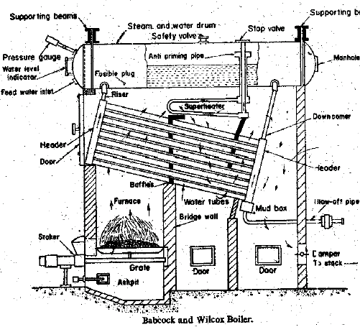
FIGER:- babcock and wilcox boiler

Slide 5
Construction of Babcock and Wilcox Boiler
1. Steam and water drum (boiler shell)
2. Water tubes
3. Uptake-header and down corner
4. Grate
5. Furnace
6. Baffles
7. Super heater

Slide 6
Construction of Babcock and Wilcox Boiler
8. Mud box
9. Inspection door
10. DamperSteam and water drum (boiler shell):One half of the drum which is horizontal is filled up with water and steam remains on theother half. It is about 8 meters in length and 2 meter in diameter.Water tubes:Water tubes are placed between the drum and furnace in an inclined position (at an angle of10 to 15 degree) to promote water circulation.

Slide 7
Boiler Mountings and Accessories
Fitting and devices which are necessary for the safety and control are knows as boiler mountings
Fitting or devices which are provided to increase the efficiency of the boiler and help in the smooth working of the plant are knows as boiler accessories.
Fittings which are essential from the safety point of view are as follows,
Water level indicators
Safety valves
Combined high steam and low water safety valve
Fusible plug

Slide 8
Boiler Mountings and Accessories contd….
Fittings which are essential from the control point of view are as follows,
Pressure gauge
Junction or stop valve
Feed check valve
Blow-off cock
Man hole and Mud Box
The important accessories are
Superheater
Economiser
Air-preheater
Feed pump or injector

Slide 9
ADVANTAGES:-
1) Both solid and liquid fuel can be burnt.
2) Minimum draught losses.
3) High evaporation.
4) Natural water circulation.
5) Defective tubes can be easily replaced.

Slide 10
THANK YOU !!!!!!

