Slide 1
Pacific School Of Engineering

Slide 2
A presentation on
Vapor Compression Refrigeration
And
Vapor Absorption
Refrigeration

Slide 3
Guided By:-
Asst.Prof.Vatsal patel
Submitted by:-
Kotadiya Reshma :- 131120131025
Ladva Piyush :- 131120131026
Mangroliya Kishan:- 131120131027

Slide 4
Introduction
What is Refrigeration System ?
The mechanism used for lowering or producing low temp. in a body or a space, whose temp. is already below the temp. of its surrounding, is called the refrigeration system.
Here the heat is being generally pumped from low level to the higher one & is rejected at high temp.

Slide 5
Refrigeration
The term refrigeration may be defined as the process of removing heat from a substance under controlled conditions.
It also includes the process of reducing heat & maintaining the temp. of a body below the general temp. of its surroundings
In other words the refrigeration means a continued extraction of heat from a body whose temp is already below the temp. of its surroundings

Slide 6
Types of Refrigeration
Vapor Compression Refrigeration (VCR):- uses mechanical energy.
Vapor Absorption Refrigeration (VAR):- uses thermal energy.
Thermo Electric Refrigeration System.

Slide 7
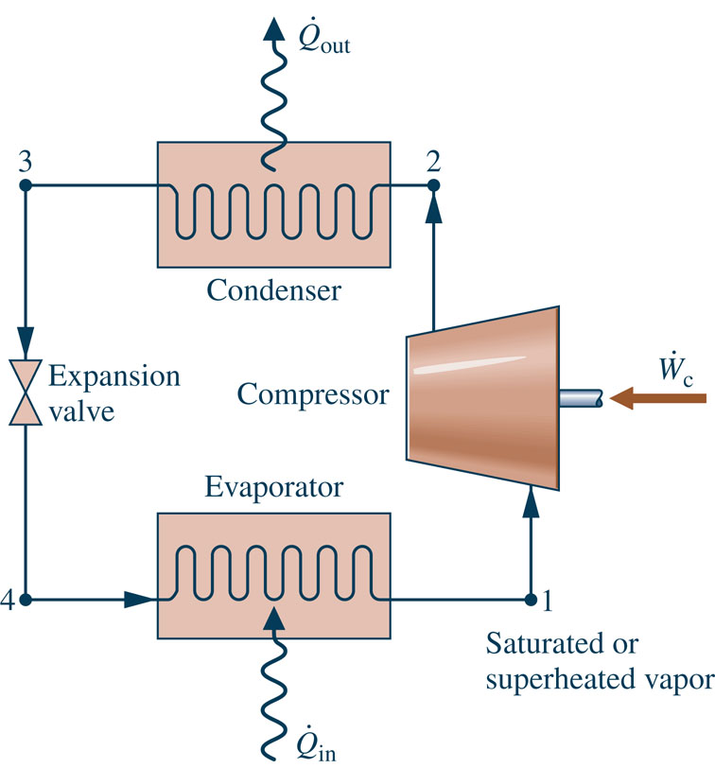
Most common refrigeration cycle in use today
There are four principal control volumes involving these components:
Evaporator
Compressor
Condenser
Expansion valve
Two-phase
liquid-vapor mixture
All energy transfers by work and heat are taken as positive in the directions of the arrows on the schematic and energy balances are written accordingly.
Notes:
Figure 10.3

Slide 8
The processes of this cycle are
Process 4-1: two-phase liquid-vapor mixture of refrigerant is evaporated through heat transfer from the refrigerated space.
Process 1-2: vapor refrigerant is compressed to a relatively high temperature and pressure requiring work input.
Process 2-3: vapor refrigerant condenses to liquid through heat transfer to the cooler surroundings.
Process 3-4: liquid refrigerant expands to the evaporator pressure.
Two-phase
liquid-vapor mixture

Slide 9
Applying mass and energy rate balances
Evaporator:-
(Eq. 1)
The term is referred to as the refrigeration capacity, expressed in kW in the SI unit system or Btu/h in the English unit system.
A common alternate unit is the ton of refrigeration which equals 200 Btu/min or about 211 kJ/min.

Slide 10
p-h Diagram
The pressure-enthalpy (p-h) diagram is a thermodynamic property diagram commonly used in the refrigeration field.

Slide 11
Vapor Compression Refrigeration
Advantages
Lot of heat can be removed (lot of thermal energy to change liquid to vapor).
Heat transfer rate remains high (temperature of working fluid much lower than what is being cooled).
It is low running cost.
It’s C.O.P is high.
The required temperatures of the evaporation can be achieved simply by adjusting the control valve.
It is smaller in size for given capacity of refrigeration.

Slide 12
Ammonia-Water Absorption Refrigeration
Absorption refrigeration systems have important commercial ad industrial applications.
The principal components of an ammonia-water absorption system are shown in the figure.
Absorber
coolant

Slide 13
Ammonia-Water Absorption Refrigeration
The left-side of the schematic includes components familiar from the discussion of the vapor-compression system: evaporator, condenser, and expansion valve. Only ammonia flows through these components.
Absorber
coolant
Notes:
13

Slide 14
Ammonia-Water Absorption Refrigeration
The right-side of the schematic includes components that replace the compressor of the vapor-compression refrigeration system: absorber, pump, and generator. These components involve liquid ammonia-water solutions.
Absorber
coolant
Notes:
14

Slide 15
Ammonia-Water Absorption Refrigeration
A principal advantage of the absorption system is that – for comparable refrigeration duty – the pump work input required is intrinsically much less than for the compressor of a vapor-compression system.
Absorber
coolant
Notes:
15

Slide 16
Ammonia-Water Absorption Refrigeration
Specifically, in the absorption system ammonia vapor coming from the evaporator is absorbed in liquid water to form a liquid ammonia-water solution.
The liquid solution is then pumped to the higher operating pressure. For the same pressure range, significantly less work is required to pump a liquid solution than to compress a vapor (see discussion of Eq. 6.51b).
Absorber
coolant
Notes:
16

Slide 17
Ammonia-Water Absorption Refrigeration
However, since only ammonia vapor is allowed to enter the condenser, a means must be provided to retrieve ammonia vapor from the liquid solution.
This is accomplished by the generator using heat transfer from a relatively high-temperature source.
Absorber
coolant
Notes:
17

Slide 18
Ammonia-Water Absorption Refrigeration
Steam or waste heat that otherwise might go unused can be a cost-effective choice for the heat transfer to the generator.
Alternatively, the heat transfer can be provided by solar thermal energy, burning natural gas or other combustibles, and in other ways.
Absorber
coolant
Notes:
18

