Slide 1
Steam Boilers
Guided By:
Mr. Bharat K. Khalasi
[Asst.Prof. Mechanicl Engg. Dept.]
Prepared By:
Belim Aktarmahamad (131120109008)
Snehal Bhimani (131120109010)
Sandip Bhalani (131120109009)
[Electrical Engineering Department]

Slide 2
Classification of boilers
Clasification of boilers
1. Depending upon to the position of water and flue gases :
(a) Smoke tube or fire tube boilers
(b) Water tube boilers
2. Depending upon to the position furnace :
(a) Internally fired boilers
(b) Externally fired boilers
3. Depending upon the position of axis of the boiler:
(a) Vertical boilers
(b) Horizontal boilers
4. Depending upon to the service which the boiler are put , like stationary, portable, marine or locomotive boiler etc.
5. Depending upon the source of heat
6. According to the method of circulation of water and steam :
(a) natural circulation
(b) forced circulation
7. According to pressure of steam genreted:
8. According to nature of draught empoyed:
1.Depending upon to the position of water and flue gases :
(a) Smoke tube or ire tube boilers
(b) Water tube boilers
2. Depending upon to the position furnace :
(a) Internally fired boilers
(b) Externally fired boilers
3. Depending upon the position of axis of the boiler:
(a) Vertical boilers
(b) Horizontal boilers

Slide 3
Classification of boilers
5. Depending upon the source of heat
6. According to the method of circulation of water and steam :
(a) natural circulation
(b) forced circulation
7. According to pressure of steam generated:
8. According to nature of draught employed:

Slide 4
Classification of Boiler
1. Depending upon to the position of water and flue gases :
(a) Smoke tube or fire tube boilers:
in these type of boiler the hot gases or the flue gases from the furnace are passed through the tubes surrounded by the water outside to be evaporated.
Examples:
Cochran, Lancashire, Locomotive boilers etc.
(b) Water tube boilers:
in these boilers the water to be evaporated passes through the tube and the gases from the furnace are passed over the external surface of the tubes.
Examples:
Babcock-wilcox boilers etc.

Slide 5
Classification of Boiler
2. Depending upon to the position furnace :
(a) Internally fired boilers:
in these the furnace is inside the body of the boiler shell.
Examples:
Lancashire, locomotive boilers etc.
(b) Externally fired boilers:
in these the furnace is outside the boiler shell.
Examples:
Babcock-wilcox, Loffler boilers etc.

Slide 6
Classification of Boiler
3. Depending upon the position of axis of the boiler:
(a) Vertical boilers:
In which the axis of the boiler shell is in vertical plane.
(b) Horizontal boilers:
In which the axis of the boiler shell is in the horizontal plane.

Slide 7
Classification of Boiler
4. Depending upon to the service which the boiler are put , like stationary, portable, marine or locomotive boiler etc.

Slide 8
Classification of Boiler
5. Depending upon the source of heat:
The source of heat may be due to:
* heat generated due to combustion of solid , liquid or gaseous fuels.
* hot waste gases or electrical energy or atomic energy etc.

Slide 9
Classification of Boiler
6. According to the method of circulation of water and steam :
(a) natural circulation:
In case of natural circulation steam boilers, the water is circulated by natural convection which are set up due to heating of water. the temperature gradient the density gradient along the length of the tube due to which water flows from high density water to low density water and steam .
Examples:
Babcock-wilcox boiler.
(b) forced circulation :
In forced circulation boiler, the water is circulated with the help of centrifugal pump driven by external source of power. such a method of water circulation is usually employed in high pressure boilers.
Examples:
Loafers boilers.

Slide 10
Classification of Boiler
7. According to pressure of steam generated:
(a) the boiler which produce steam at less than 20 bar pressures are called pressure boilers.
Examples:
Cochran, lancashire, locomotive boilers etc.
(b) the boiler which produce steam above 20 bar pressures are called high pressure boiler.
Examples:
Babcock-wilcox, Loffler boilers etc.

Slide 11
Classification of Boiler
8. According to nature of draught employed:
When the fuel is burnt on the surface due to natural circulation of air, the draught is called natural or chimney draught. If the air is circulation with the help of fan driven by external source of power, the draught is called artificial draught.

Slide 12
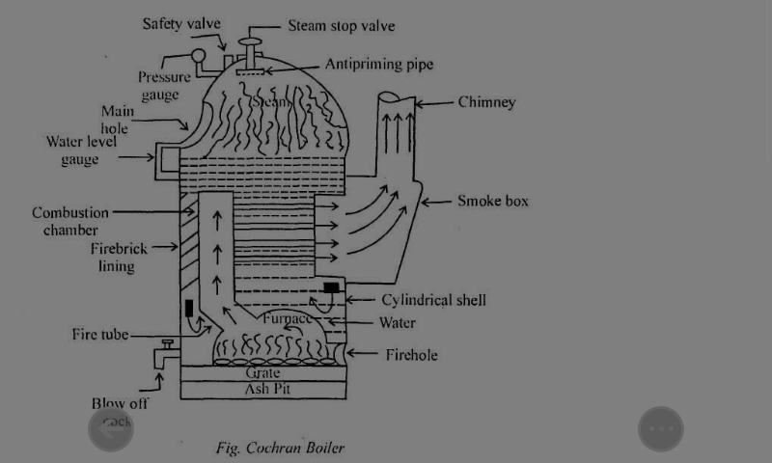
Cochran boiler
Cochran boiler is modification of simple vertical boiler where heating surface has been increased by increasing number of fire tubes

Slide 13
Characteristics of boiler
Vertical
Multi- tubes
Fire tube
Internally fired
Natural circulated boiler

Slide 14
Specification
Shell diameter
Height
Heating surface area
Working pressure
Steam capacity
efficiency

Slide 15
Construction
The boiler consist of a cylindrical shell, hemispherical fire box, fire tube and chimney.
The hemispherical crown of boiler gives good strength to withstand pressure of steam inside the boiler
The grate is placed at the bottom of furnace and ash pit is located below the grate.
The furnace and the combustion chamber are connected by short flue pipe.
The wall of the combustion chamber is lined with the fire bricks.
The ashpit is located below the grate.

Slide 16
Working
The water supplied to the boiler through feed check valve.
The coil is introduced to the grate through the fire door.
This hot gases enters into horizontal fire tubes.
The flue gases coming from of fire tubes enter into smoke box.
The ash formed is collected in ash pit.

Slide 17
Advantages
It is compact and portable boiler therefore minimum floor area is required
Initial cost of boiler is less.
It can be moved and set up readily in different locations.
Quick and easy installation
Any type of fuel can be used coil or oil

Slide 18
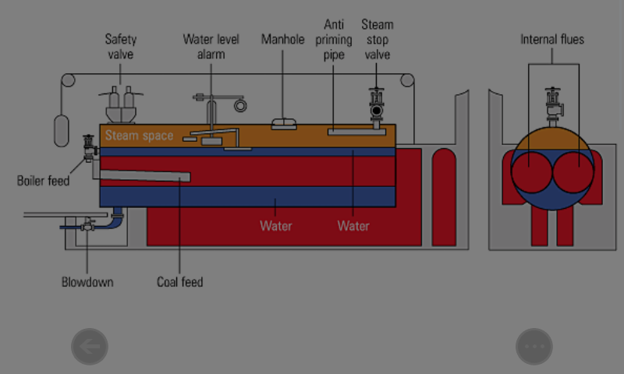
Lancashire boiler

Slide 19
Disadvantages
Steam raising capacity is less due to vertical design.
Water along with steam may enter the steam pipe under heavy loads due to small steam space.
Efficiency is poor in smaller sizes.

Slide 20
specification
Shell diameter
Length of the shell
Maximum working pressure
Steam capacity
efficiency

Slide 21
Characteristics
Horizontal
Stationary
Fire tube
Internally fired multi-tube
Natural circulation of hot gases
Medium pressure boiler

Slide 22
construction
The cylindrical shell is placed over the brick structure.
The boiler have three passes for flow of flue gases.
One flue passes from inside of boiler and through fire tubes, is called main flue(MF).
Second flue passes from below the shall is called bottom flue(BF)
Third from the side of boiler is called side flue(SF).
The fuel grates are provided at the front end inside of two main fire tubes.
Damper are placed at the end of the side flues to control the flow of gases.

Slide 23
Working
The coil is introduced to the great through fire holes.
The combustion will produce hot gases.

Slide 24
Advantages
The fluctuations in load can be easily met by this boiler due to large reservoir.
Easy operation.
Low maintenance costs.
Easy to clean and inspect.
By use of economiser and superheater
Maximum heat of flue gases is utilized,so efficiency of boiler can be increased.

Slide 25
Disadvantages
Maximum working pressure is limited to 16 bars.
Due to brick work, more floor area is required
Response of pressure build up is less.
The furnace is inside the tubes therefore the grate area is restricted.

Slide 26
Babcock and wilcox water tube boiler

Slide 27
Specification
Diameter of the drum
Length
Size of the water tubes
Size of superheated tubes
Maximum working pressure
Maximum steaming capacity
Efficiency

Slide 28
Characteristics
Horizontal
Multi-water tube
Externally fired
Natural circulation of water
Forced circulation for air and hot gases
Solid as well as liquid fuel fired

Slide 29
construction
The drum is connected to up take and down take header by short riser tubes.
These header are connected to a series of inclined water tubes.
The water tube inclined to the horizontal about 15 or above to bring natural circulation of water.
The baffles plates are provided in order to make the circulation of hot gases in same from
Soot doors are also help to access the interior of the boiler

Slide 30
Working
The water is fed into the drum through the feed check valve.
Then water collects in the drum.
Initially one half of drums is filled up with water
The coil is introduced to furnace grate by help of stroker
The damper controls the flow of air into the furnace
They are heated by hot gases coming from furnace
Due to heating of the water,dencity of water decreases
Low dencity water moves upward in water tubes

Slide 31
Advantages
Steam generation capacity is very high,about 2000 to 40,000 kg/hr
Replacement of defective tubes is easy
The draught losses as compared to another boilers is minimum
It is used in power station for generating large quantity of steam
Boiler is required less space area compared to fire tube boilers and offers greather operational safety

Slide 32
Vertical boiler
It is the simplest form of vertical boiler is used for small power generation.
It is used for steam generation at lower rate
The boiler consists of cylinder shellfire fox, cross water, tubes and chimney as shown figure

Slide 33
Characteristics
A portable
Vertical
Water tubes
Multi-tube
Internally fire
Natural circukleted
Low pressure boiler

Slide 34
construction
The boiler is fiffted with all necessary mountinh,as under
(1)feed cheak value
(2)Water level indicatore
(3)Pressure gauge
(4)Steam stop value
(5)Saftey valve
(6)A man hole
(7)Hand holes
(8)Blow of cock
(9)A chimeny

Slide 35
Working
The water is supplyed to the boiler through feed cheak value
The coil is introduceed to the great whrere the fule is brunt throu the fire.
The boiler is then fired.
The chimeny is provided to exhaust the hot gause.
The water is convert to steam due to heat gain from hot gases.

Slide 36
Advantages
Compact and requires less floor space
Not require heavy foundation
Produse pressure up to 10 bar and steam genretion rate possible up to 2500 kg/hour

Slide 37
THANK YOU

