Slide 1
Pacific school of Engineering, SURAT
INSTITUTE CODE:112
SUBJECT :- ELEMENTS OF ELECTRICAL ENGINEERING
Submitted by:-
Kotadiya Reshma 26
Maniya Saguna 30
Sojitra Rachna 54
Sidpara Pooja 52
Guided by:-
Hitesh Patel
Vidhi Mody
BRANCH:- COMPUTER SCIENCE AND ENGINEERING

Slide 2
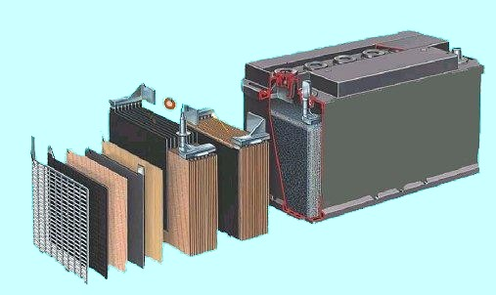
BATTERIES AND BATTERY CHARGING

Slide 3
Charging
Chemical reaction occur during charging.
Lead sulfate on both plates is separated into Lead (Pb).
Sulfate (SO4) leaves both plates.
It combines with hydrogen (H) in the electrolyte to form sulfuric acid (H2SO4).
Oxygen (O) combines with the lead (Pb) at the positive plate to form lead oxide (PbO2).
The negative returns to original form of lead (Pb.

Slide 4
Charging
Clean Battery Terminals.
Attach clamps to the battery in proper polarity.
Keep open flames and sparks away from battery.
Ventilate the battery well while charging.

Slide 5
Charging
The charge a battery receives is equal to the charge rate in amperes multiplied by the time in hours.
Measure the specific gravity of a cell once per hour during charging to determine full charge.
Notes:
Thus a 5-A rate applied to a battery for 10 h would be a 50 - a-h charge to the battery.
To fully recharge a battery, you must replace the ampere hours or ampere minutes removed from it plus an extra 20 % charge.
This is due to the fact the batteries are not 100 % efficient on recharging.

Slide 6
Overcharging
Results in warped or broken plates, damaged separators, severe shedding of the active materials pasted to the plates, and excessive loss of water, which cause plates to dry out.

Slide 7
TYPES OF RECHARGABLE LEAD ACID BATTERIES
STARTING/CRANKING BATTERIES
DEEP CYCLE BATTERIES
DUAL PURPOSE BATTERIES

Slide 8
TYPES OF RECHARGABLE LEAD ACID BATTERIES
STARTING/CRANKING BATTERIES
MANY THIN PLATES
LARGE AMOUNT OF CURRENT DELIVERY OVER SHORT TIME
DAMAGE CAUSED IF DEEPLY DISCHARGED

Slide 9
TYPES OF RECHARGABLE LEAD ACID BATTERIES
DEEP CYCLE BATTERIES:-
FEWER THICKER PLATES
LOWER CURRENT DELIVERY OVER LONG PERIODS
CAN BE DISCHARGED BY 50% WITHOUT DAMAGE
CAN BE CYCLED MANY TIMES

Slide 10
TYPES OF RECHARGABLE LEAD ACID BATTERIES
DUAL PURPOSE BATTERIES:-
COMPROMISE BETWEEN MANY THIN PLATES AND FEWER THICK PLATES
CAN BE DISCHARGED BY 50%
FEWER CYCLES THAN DEEP CYCLE BATTERY

