Slide 1
SHREE J.M.SABVA INSTITUTE OF
ENGINEERING &TECHNOLOGY, BOTAD
CONSTRUCTION MATERIALS
TIMBER
1.BELADIYA VISHAL R.
2.PARMAR PRAKASH K.
3.DESAI PARAS V.
4.PARMAR VISHAL D.
5.GOHEL KAMLESH B.

Slide 2
WHAT IS TIMBER ?
Timber is one of the oldest structural materials used by them.
TREE
EXOGENOUS
ENDOGENOUS

Slide 3
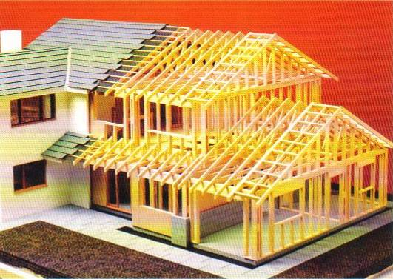
Timber Framed Structures

Slide 4
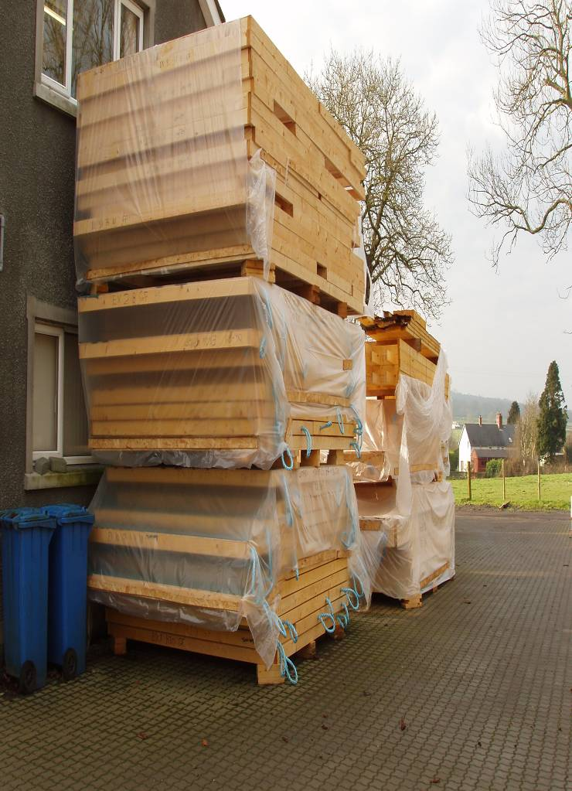
Advantages of timber framed construction.
Timber framed construction allows for the use of semi skilled labour for the manufacture in factory controlled conditions.
Rapid completion on site is easily achieved with less wet trades involved.
The occupier of a timber framed dwelling benefits from the higher insulation which can easily be achieved. The use of low thermal capacity linings absorbs less heat than masonry walls making it is easier to reach the required comfort temperature more quickly.

Slide 5
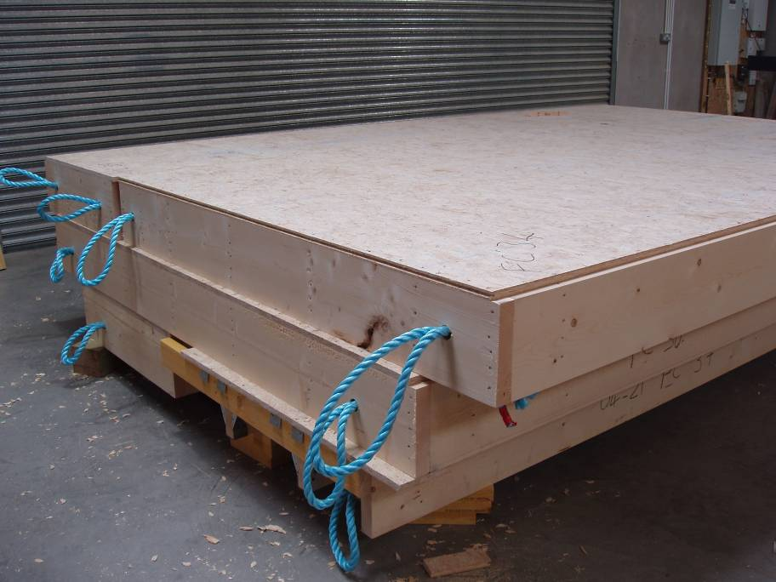
Manufacturing Process
Timber framed houses are usually made in factories into large wall sized units which make economic use of materials.
The manufacturing process is not effected by inclement weather.
Timber framed panels in the workshop ready for erection.

Slide 6
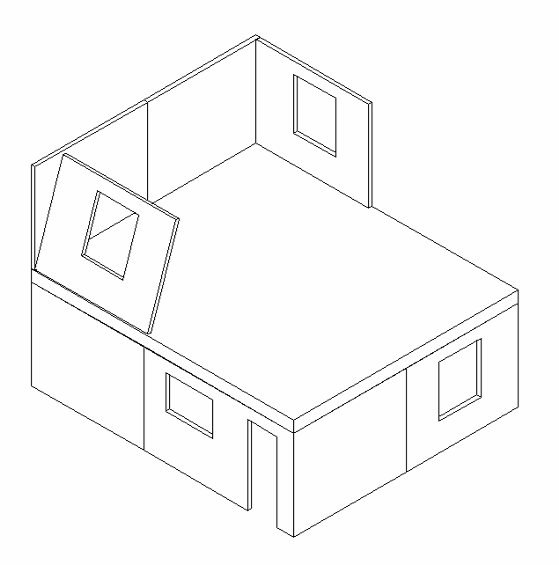
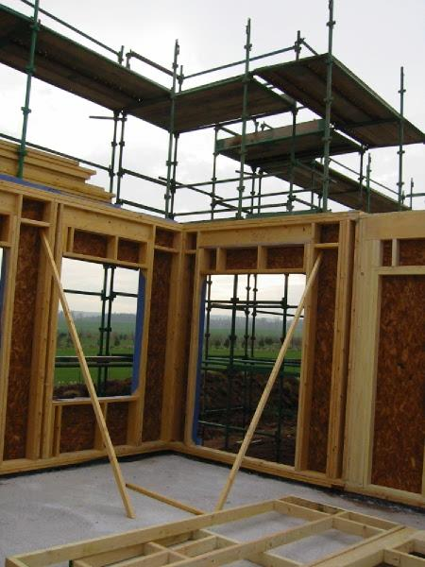
Platform framed structures.
The most common method of constructing a timber framed structure is a platform frame.
With this method each storey is framed up as a separate operation making use of each floor as an erection platform.
Another method of construction is balloon frame. In this method of construction the building is fabricated from wall sections two storeys high.
It is not used for three storey structures.

Slide 7
External walls
The structural framed members of the external walls are constructed with light softwood timbers which are designed using stress graded timber to BS4978. The studs are usually processed from basic sawn sizes of either 100 x 50mm or 75 x 50mm. These studs are usually spaced at 400mm centres. The studs are nailed with simple butt joints to top and bottom plates of the same size.
Panel sizes is dictated by an early decision on whether they are to be craned or manually lifted into position.
The external walls are braced with sheet materials, usually water boil proof (WBP) plywood, nailed or stapled to the external face of the frame.

Slide 8
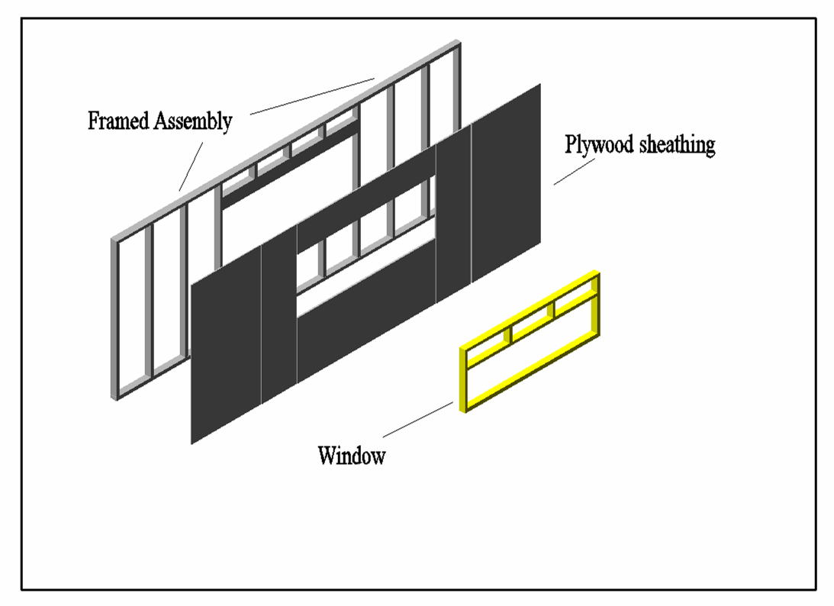
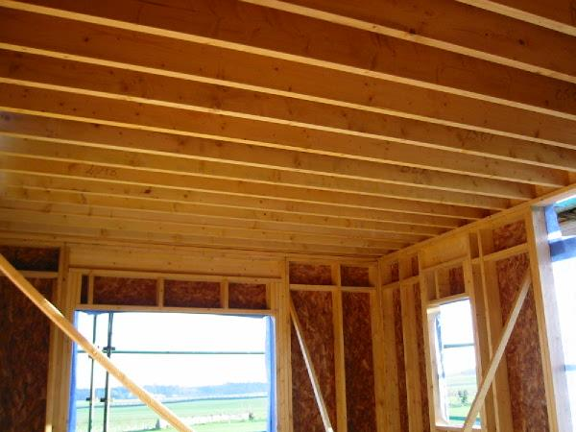
Drawing of an external walls

Slide 9
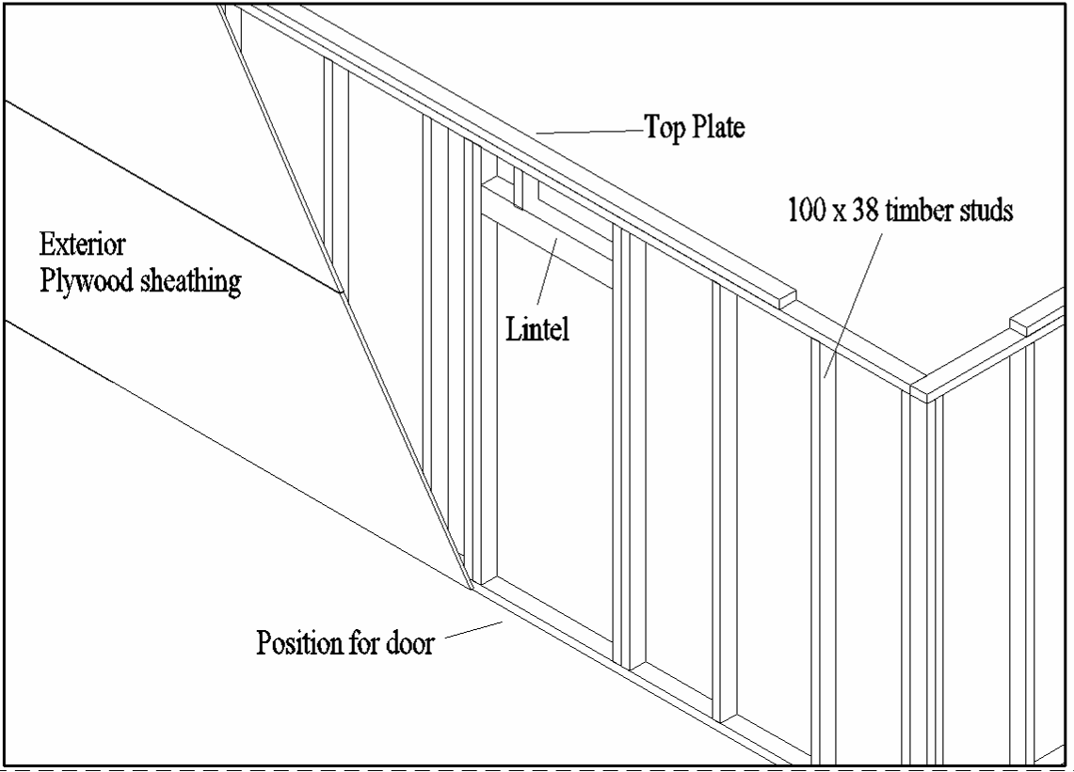

Slide 10
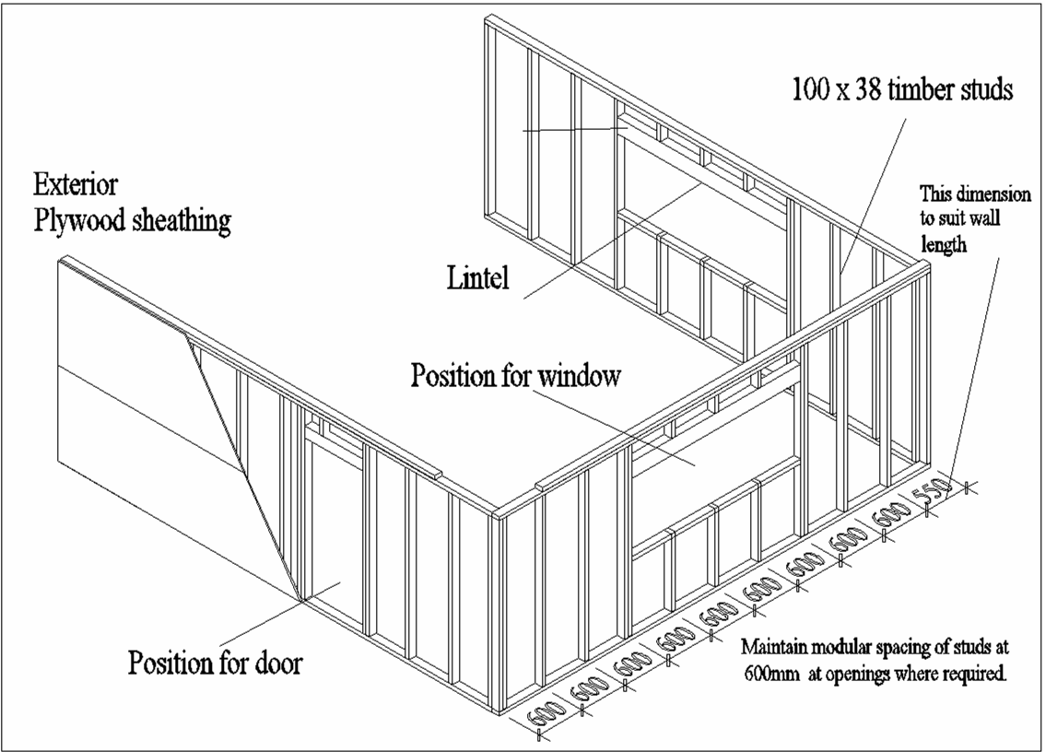
Timber Stud Walls

Slide 11
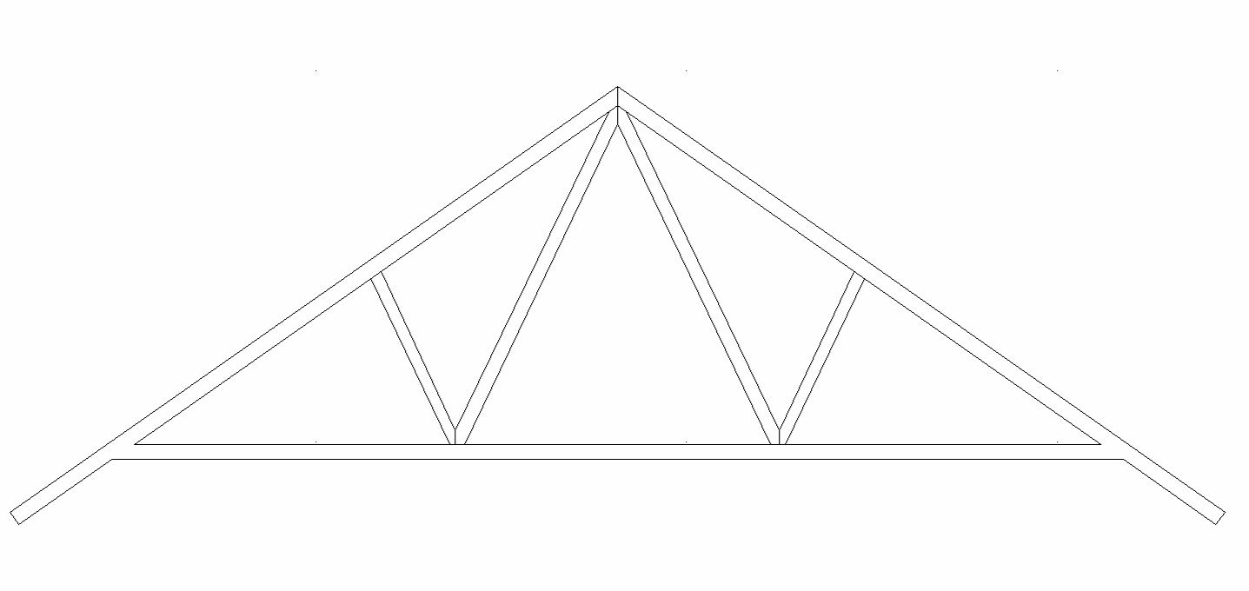
Trussed Rafter
Trussed Rafters are used on most timber framed houses.

Slide 12
Timber Framed structures under erection

Slide 13
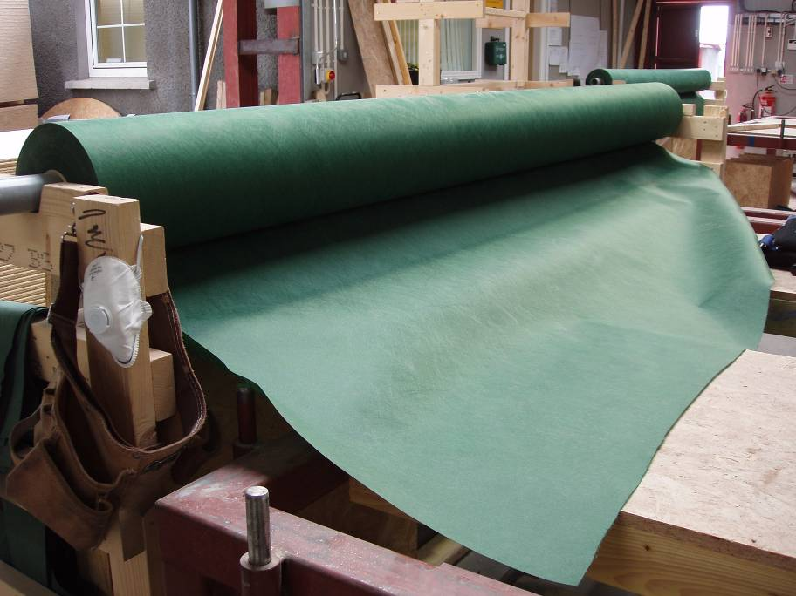
Breather Membrane
To prevent moisture entering into the plywood sheathing during construction a breathable membrane is stapled onto the plywood on the external face. This membrane also provides a second line of defence should moisture penetrate the exterior cladding.

Slide 14
External Cladding
External cladding can be chosen from a wide range of materials which include brickwork secured across a cavity to the timber frame with flexible metal ties.
The flexible wall ties are used to allow for differential movement between the brick cladding and the timber frame.
The brick cladding must be designed in such a way to allow for movement at projecting windows sills and under roof structures.

Slide 15
External Cladding
A Inner Lining of Plasterboard
B Vapour Check
C Structural Timber Frame
D Thick Insulation Quilt-CFC free
E Sheathing Board
F Waterproof Breather Membrane
G Stainless Steel Wall Tie
H Clear 50mm Wall Cavity
I Brick Outer Cladding

Slide 16
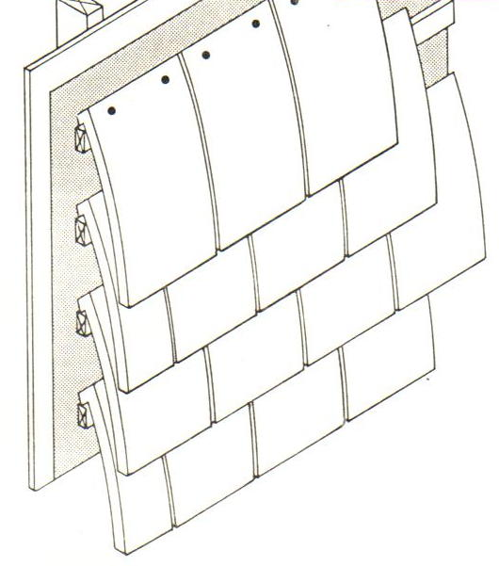
External Cladding
Roofing tiles may also be used as a cladding material. These tiles are hung on timber battens which have been secured to the plywood. These battens must be treated with a timber preservative prior to being secured to the plywood.

Slide 17
THANK YOU

