Slide 1
GUJARAT TECHNOLOGICAL UNIVERSITY BIRLA VISWAKARMA MAHAVIDHYALAYA (ENGINEERING COLLEGE) VALLABH VIDYANAGAR
SUBJECT: ELEMENTS OF CIVIL ENGINEERING (CODE-2110004)
BE First Level First Semester (Self Finance)
PRACTICAL: LEVELLING : Calculate RL by HI and Rise & fall method
PREPARED BY:
STUDENTS NAME | ID.NO. | ENROLLMENT NO.
Lapsiwala Vishal | 13PES22 | 130080125010
Lathiya Piyush | 13PES23 | 130080125011
Choudhary Ritu | 13PES25 | 130080125027
Prof. C.B. Mishra, Civil Engg. BVM

Slide 2
Aim: To determine reduced levels of staff station
Apparatus: Dumpy level, levelling staff, tripod stand
Procedure:
Check the position of levelling instruments in the box.
Set the tripod stand firmly fixed in the ground at required height of the surveyor and mount the dumpy level on it.
Perform temporary adjustments of a level by the steps shown:
All the three foot screws of the dumpy level are first of all brought at the center of its run.
Telescope should be made parallel to two foot screws and bubble should be brought in the center by moving the screws either inward or outward till the bubble comes in the center of run.
Telescope is made perpendicular to two foot screws and third screw is adjusted either clockwise or anticlockwise in such a way that bubble is in the centre of its run.
Repeat the process of centering till the bubble remains in the center for all positions of the telescope.
Focusing the eyepiece till cross hairs are visible.
Focusing the object glass till the image of staff is clear, distinct & sharp.
Observe the readings of each station and enter the readings in observation table.
Compute the Reduced Levels of each station by HI & Rise and Fall method.

Slide 3
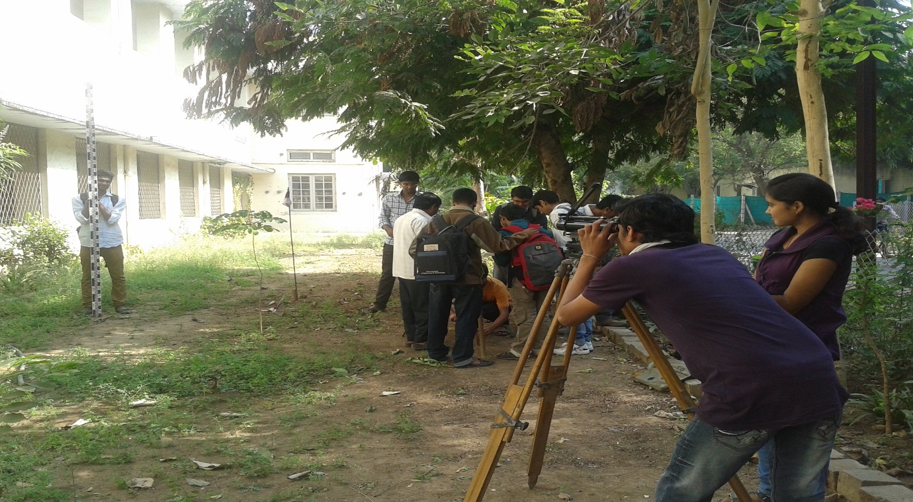
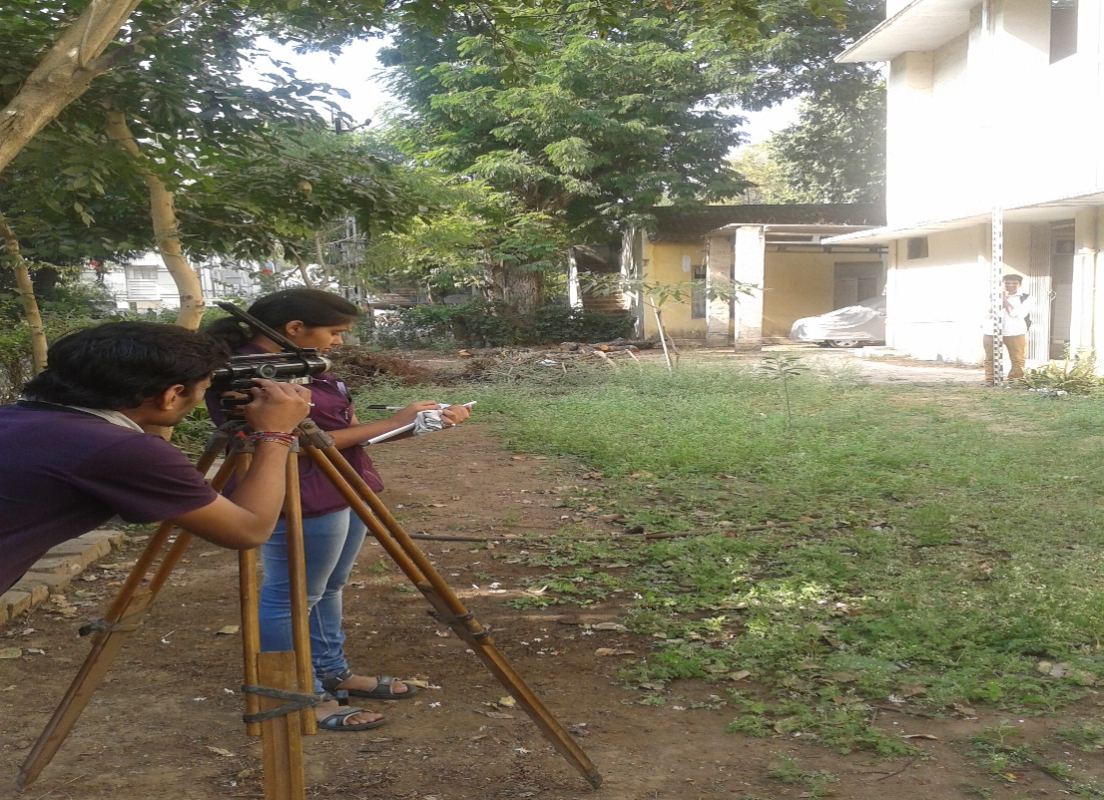
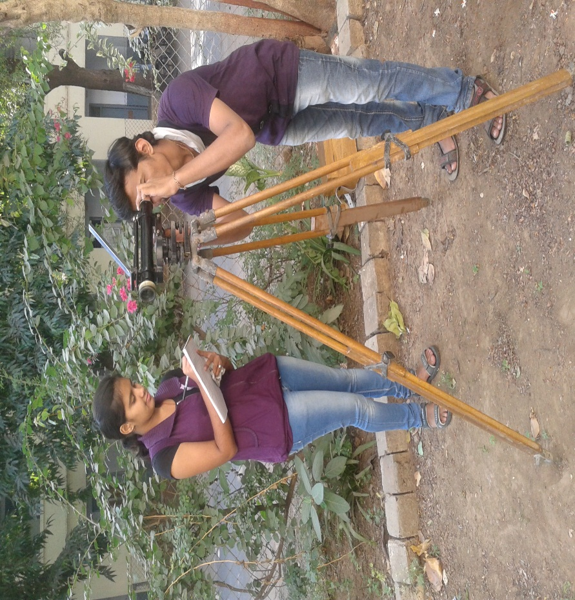
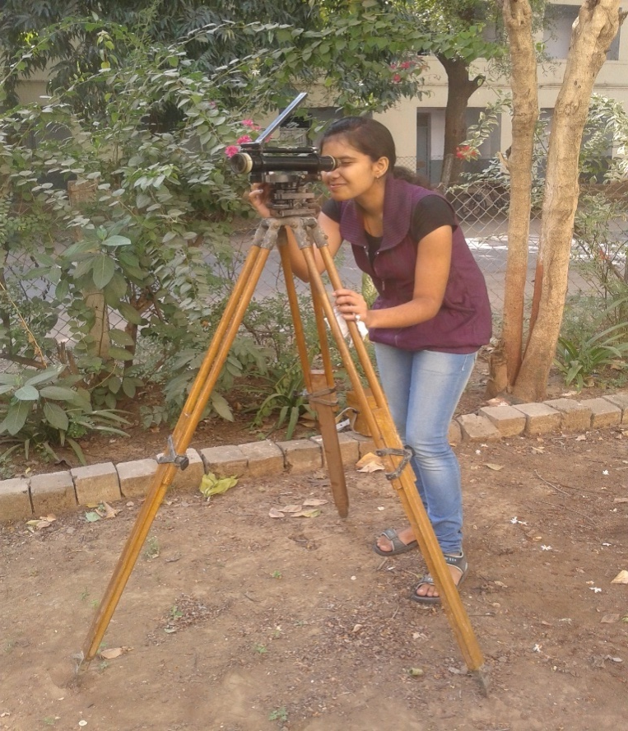

Slide 4
Figure of Dumpy Level

Slide 5
Definition
A level surface is a surface which is everywhere perpendicular to the direction of the force of gravity. An example is the surface of a completely still lake. For ordinary levelling, level surfaces at different elevations can be considered to be parallel.
A level datum is an arbitrary level surface to which elevations are referred. The most common surveying datum is mean sea-level (MSL).
An assumed datum, which is established by giving a benchmark an assumed value (e.g. 100.000 m) to which all levels in the local area will be reduced. It is not good practice to assume a level which is close to the actual MSL value, as it creates potential for confusion.
A reduced level is the vertical distance between a survey point and the adopted level datum.
A bench mark (BM) is the term given to a definite, permanent accessible point of known height above a datum to which the height of other points can be referred.
Back Sight: The first observation is made to the known point.
Intermediate Sight: Staff readings between BS and FS.
Fore Sight : The last observation is to the final point before shifting the instrument.
Change points: They are points of measurement which are used to carry the measurements forward in a run. Each one will be read first as a foresight, the instrument position is changed, and then it will be read as a back sight.
Height of Collimation is the elevation of the optical axis of the telescope at the time of the setup. The line of collimation is the imaginary line at the elevation.
Axis of Telescope: Imaginary line passing through optical center of eye piece and object glass

Slide 6
Methods to calculate reduced level.
Height of instrument method [hi].
The rise and fall method.

Slide 7
The Height Of Instrument Method.
the height of instrument is calculated by adding the backsight reading (bs) to the rl of the bm (first method).
Rl of hi = rl of bm +bs
Before shifting the instrument ,the rl of the intermediate points and changing point(CP) are obtained by subtracting the respective staff readings(IS or fs) from the rl of hi.
(1)Rl of intermediate point =rl of hi – is
(2)Rl of change point=rl of hi –fs.

Slide 8
Then the level is shifted for the next set up and again the new height of the instrument is obtained by adding the back sight reading to the Rl of CP.
Rl of Hi = Rl of CP + BS.
The height of instrument is different in different set ups of the level.
For a change point FS reading is taken before shifting the instrument and BS reading is taken on the same staff position after shifting the instrument

Slide 9
Observation Table: (BY HI Method)
Sr.No. | Station | BS | IS | FS | HI | RL | Remark
1 | A | 1.36 |  |  | 51.360 | 50.00 | RL of BM = 50.0m
2 | B |  | 1.19 |  |  | 50.17
3 | C |  | 1.04 |  |  | 50.32
4 | D |  | 0.895 |  |  | 50.465
5 | E |  | 0.735 |  |  | 50.625
6 | F |  | 0.580 |  |  | 50.780
7 | G |  | 0.535 |  |  | 50.825
8 | H |  | 0.415 |  |  | 50.945
9 | I |  |  | 1.085 |  | 50.275
 |  | ∑BS=1.36 |  | ∑FS=1.085
Arithmetic Check: ∑BS−∑FS = LRL − FRL
1.36 – 1.085 = 50.275 – 50.00
0.275 = 0.275 (Checked)

Slide 10
Calculations by HI method
HI = RL(B) + BS = 50.00 + 1.36 = 51.36 m
RL(B) =HI – IS = 51.36 – 1.19 = 50.17m
RL(C) = 51.36 – 1.40 = 50.32m
RL(D)= 51.36 – 0.895 = 50.465m
RL(E) = 51.36 – 0.735 = 50.625m
RL(F) = 51.36- 0.580 = 50.780m
RL(G) = 51.36 – 0.535 = 50.825m
RL(H) = 51.36 – 0.415 = 50.945m
RL(I) = 51.36 – 1.085 = 50.275m

Slide 11
The Rise And Fall Method.
In this method the height of the instrument is not at all calculated but the difference of the level between consecutive points is found by comparing the staff readings on the two points for the same setting of the instrument.
If the forward staff reading is smaller than the immediately preceding staff reading, it indicates a rise.
Rl of point b = rl of a + rise.
If the forward staff reading is greater than the immediately preceding staff reading, it indicates a fall.
Rl of b= rl of a- fall.
The rise is added to the rl of the preceding point to get the rl of the forward point and the fall is subtracted from the rl of preceding point to get the forward point.

Slide 12
Observation Table: (BY Rise & Fall Method)
Sr.No. | St. | BS | IS | FS | Rise | Fall | RL | Remark
1 | A | 1.36 |  |  |  |  | 50.00 | RL of BM = 50.0m
2 | B |  | 1.19 |  | 0.170 |  | 50.17
3 | C |  | 1.04 |  | 0.150 |  | 50.32
4 | D |  | 0.895 |  | 0.145 |  | 50.465
5 | E |  | 0.735 |  | 0.160 |  | 50.625
6 | F |  | 0.580 |  | 0.155 |  | 50.780
7 | G |  | 0.535 |  | 0.045 |  | 50.825
8 | H |  | 0.415 |  | 0.12 |  | 50.945
9 | I |  |  | 1.085 |  | 0.67 | 50.275
 |  | ∑BS=1.36 |  | ∑FS=1.085 | ∑Rise=0.945 | ∑Fall=0.67
Arithmetic Check: ∑BS−∑FS = LRL − FRL = ∑Rise - ∑Fall
1.36 – 1.085 = 50.275 – 50.00 = 0.945 – 0.67
0.275 = 0.275 = 0.275 (Checked)

Slide 13
Calculations by Rise & Fall Method
∑BS(a)−∑IS(b) = 1.36 -1.19 = 0.170 ( Rise of b ) | RL(b) = RL(a) + Rise (b)= 50.00 + .170 = 50.17
∑IS(b)−∑IS(c) =1.19 – 1.04 = +0.150 ( Rise of c ) | RL(c) = RL(b) + Rise(c) = 50.17 + 0.150 =50.32
∑IS(c)−∑IS(d) =1.04 – 0.895 = +0.145 ( Rise of d) | RL(d) = RL(c) + Rise(d) = 50.32+ 0.145 = 50.465
∑IS(d)−∑IS(e) =0.895 – 0.735 =+0.160 (Rise of e ) | RL(e) = RL(d) + Rise(e) = 50.465 + 0.160 = 50.625
∑IS(e)−∑IS(f) =0.735 – 0.580 =+0.155 ( Rise of f ) | RL(f) = RL(e) + Rise(f) = 50.625 + 0.580 = 50.780
∑IS(f)−∑IS(g) =0.580 – 0.535 =+0.045 ( Rise of g ) | RL(g) = RL(f) + Rise(g) = 50.780 + 0.535 = 50.825
∑IS(g)−∑IS(h) =0.535 – 0.415 =+0.12 ( Rise of h ) | RL(h) = RL(g) + Rise(h) = 50.825 + 0.415 = 50.945
∑IS(h) −∑FS(i) =0.415 – 1.085 = - 0.67 ( Fall of i ) | RL(i) = RL(h) - Fall(i) = 50.945 – 1.085 = 50.275

